Slide 1
E91 Protocol
Graeme Jacobson

Slide 2
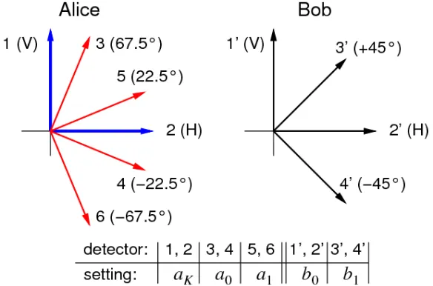
General Overview
Takes advantage of EPR States, maximum entanglement
Makes use custom sets of basis
Highly secure due to entanglement
Uses Bell’s Theorem as security measure

Slide 3
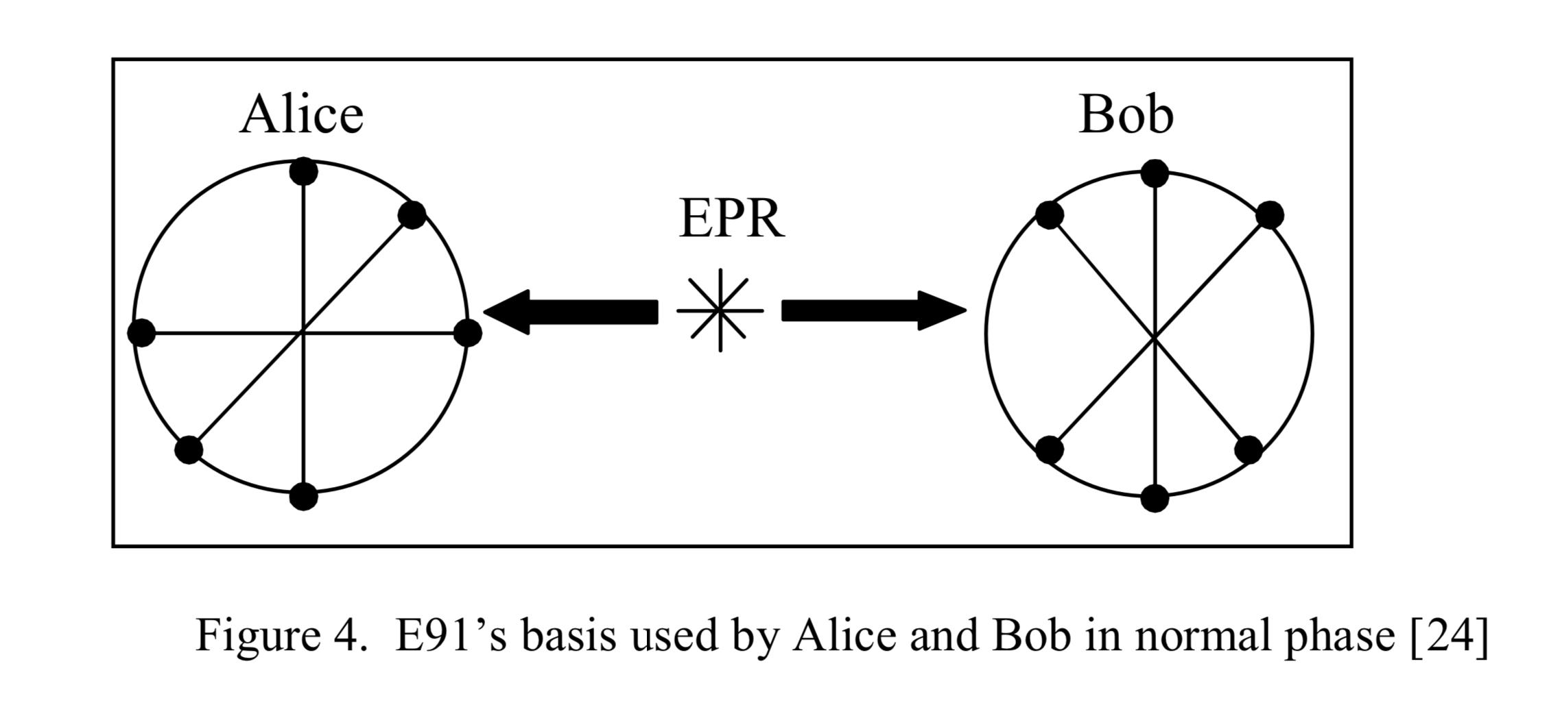
Algorithm
Prepare n pairs of qubits in Bell State, same for each
Make set of basis (1,2,3) for Alice and Bob, should share two basis
Alice and Bob receive their respective qubits via quantum channel
Each choose a random basis from decided set to make a measurement
Communicate their basis choice over classical channel
Keep the positions measured in same basis and use Alice state for key: (A1,B1), (A2,B2)
Check Bell Inequality: (A1, B2), (A1,B3), (A2,B3), (A2,B2)

Slide 4
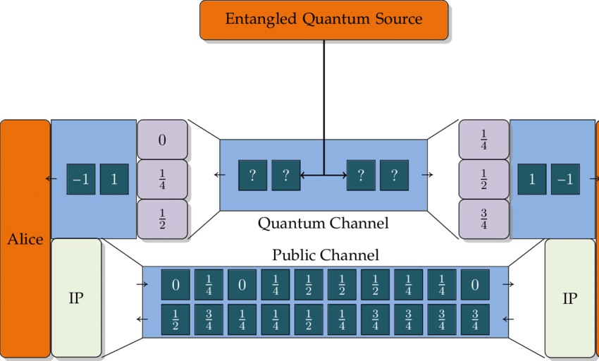
Algorithm

Slide 5
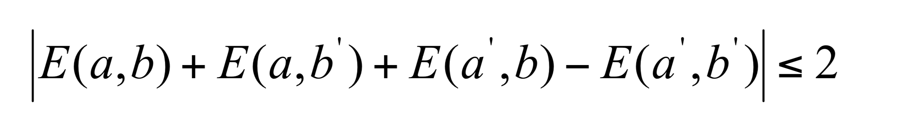
Security
Maximally entangled states cannot be eavesdropped
If there is an outside interaction, no longer maximally entangled
Take two of basis states and use for Bell’s Inequality
Maximum entangled yields 2sqrt(2) for Bell’s Inequality
Anything less may have been compromised
|(A1, B2)+(A1,B3)+(A2,B3)-(A2,B2)| <= 2

Slide 6
Sources
Ramona Wolf. (2020, June 9). Security of Quantum Key Distribution 7: Entanglement-Based Protocols. [Video]. Youtube. https://youtu.be/jYrR4JIJtVw
Lopes, M., &amp; Sarwade, D. (2014, June). Cryptography From Quantum Mechanical Viewpoint. Retrieved December, 2020, from https://arxiv.org/pdf/1407.2357.pdf
An approach to securing IPsec with Quantum Key Distribution (QKD) using the AIT QKD software - Scientific Figure on ResearchGate. Available from: https://www.researchgate.net/figure/The-Ekert-1991-E91-Protocol_fig1_306379356 [accessed 10 Dec, 2020]
McMahon, D. (2008). Quantum Computing Explained. Hoboken: John Wiley & Sons.

